Slide 1




MARKET PLACE FOR NORTHWEST One place to buy and sell
z
SEC03 TEAM03
DR. CHANDRA MOULI KOTTETI – Client/Mentor KIRAN KUMAR GUNDAPUNENI – Back End Developer HARI KIRAN ALURI – Back End Developer SAJIDA MOHAMMAD – Front End developer USHA PATI – Front End Developer

Slide 2
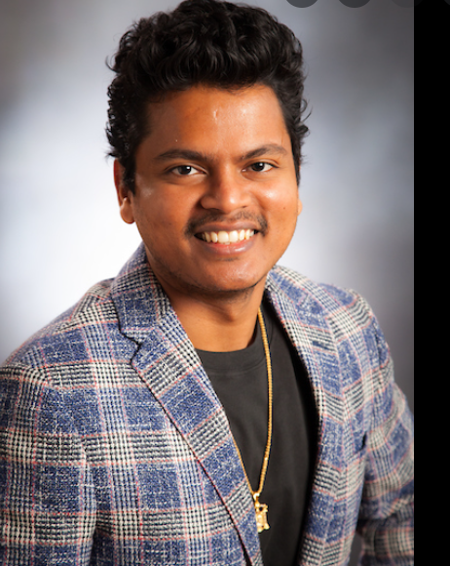
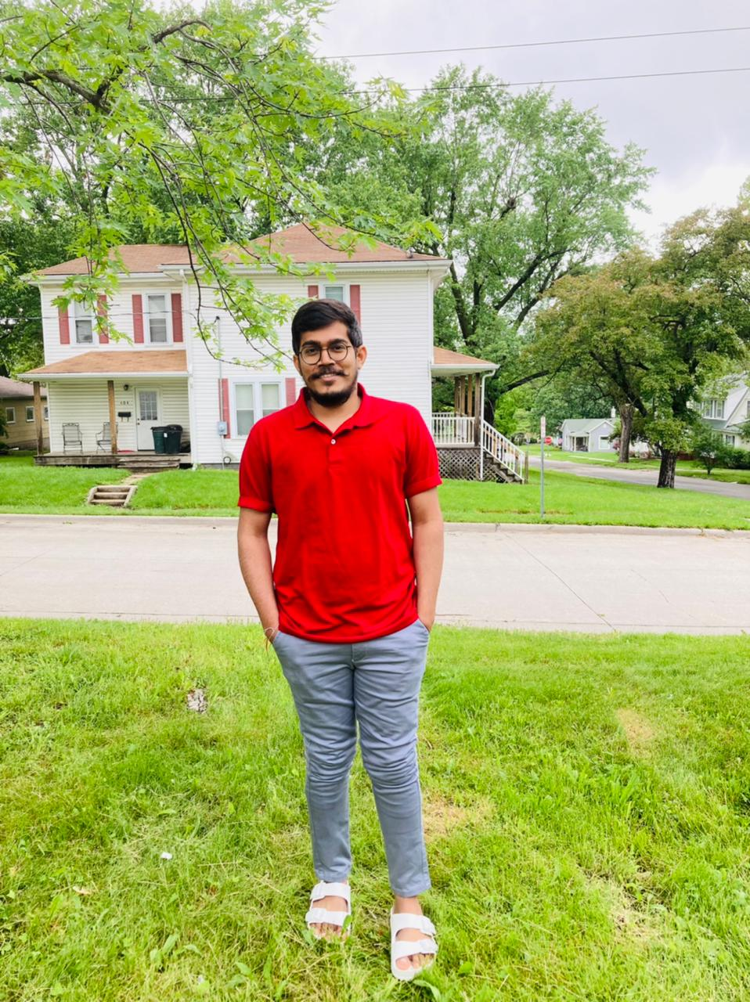
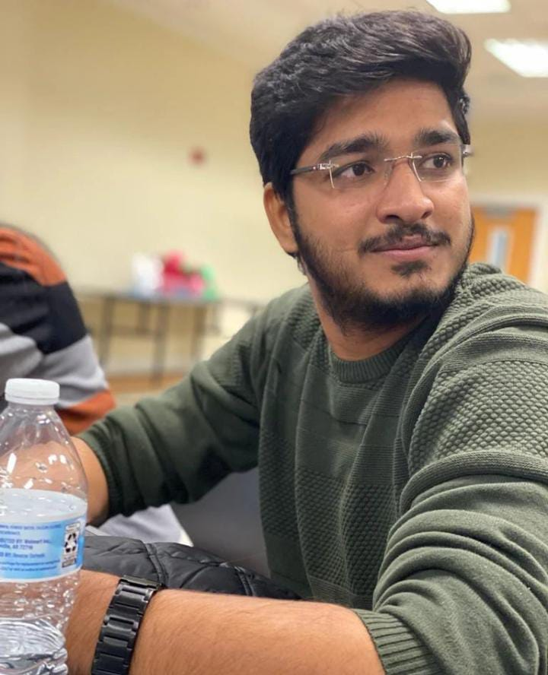
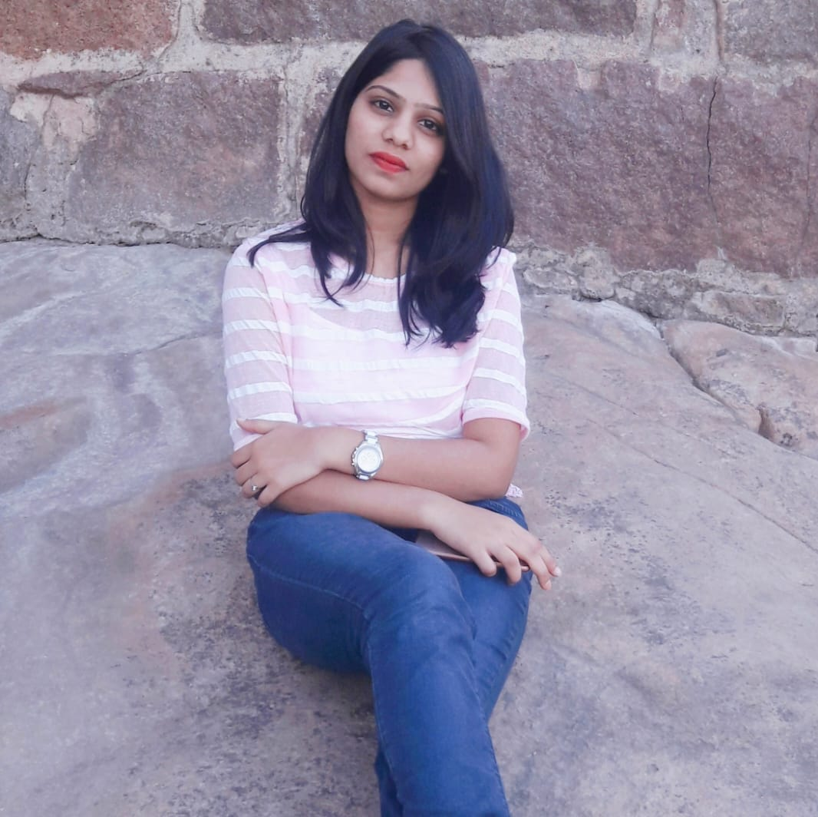
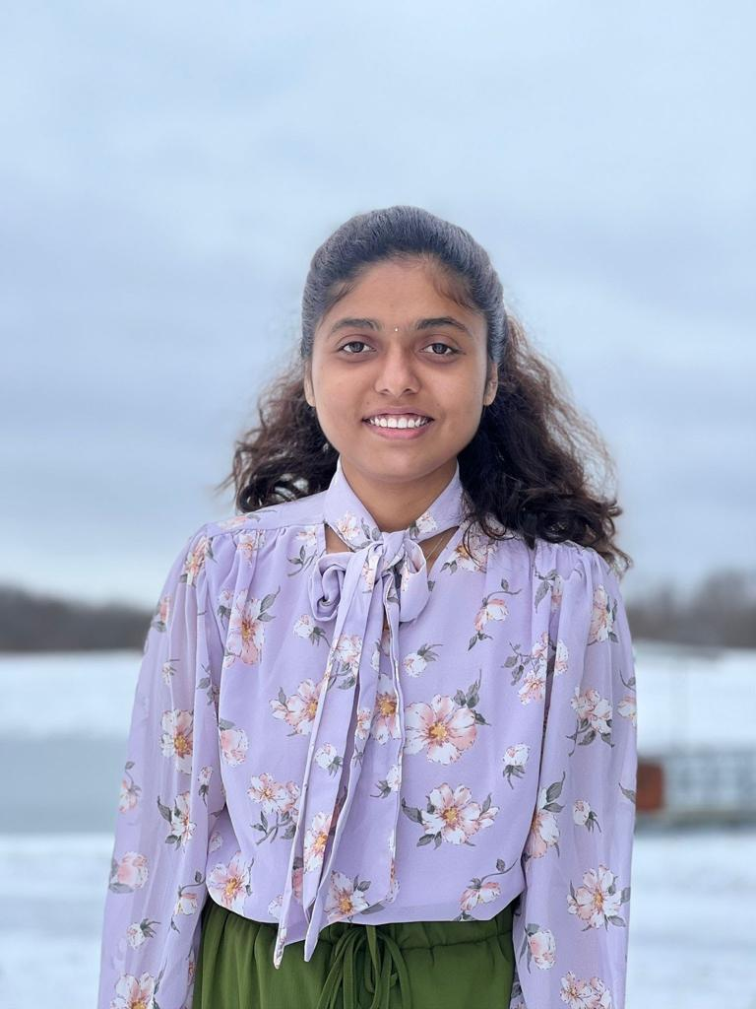
TEAM MEMBERS
DR.CHANDRA MOULI
KOTTETI
KIRAN KUMAR
GUNDAPUNENI
HARI KIRAN ALURI
SAJIDA MOHAMMAD
USHA PATI

Slide 3
TABLE OF CONTENTS
Introduction
Technical Stack
User Functionality
Sell Functionality
Ads Functionality
Lessons Learnt
Future Implementations
Summary
References
Kiran kumar Gundapuneni

Slide 4
INTRODUCTION
Market place for Northwest
Students can purchase or sell products
CURD Operations can be performed on products
Kiran kumar Gundapuneni

Slide 5




TECHNICAL STACK
Vue
Spring boot
Selenium
MySQL
Kiran kumar Gundapuneni

Slide 6
USER FUNCTIONALITIES
Login Functionality
Registration Functionality
Buy Functionality
Sell Functionality
Ads
Chat
Hari Kiran Aluri

Slide 7
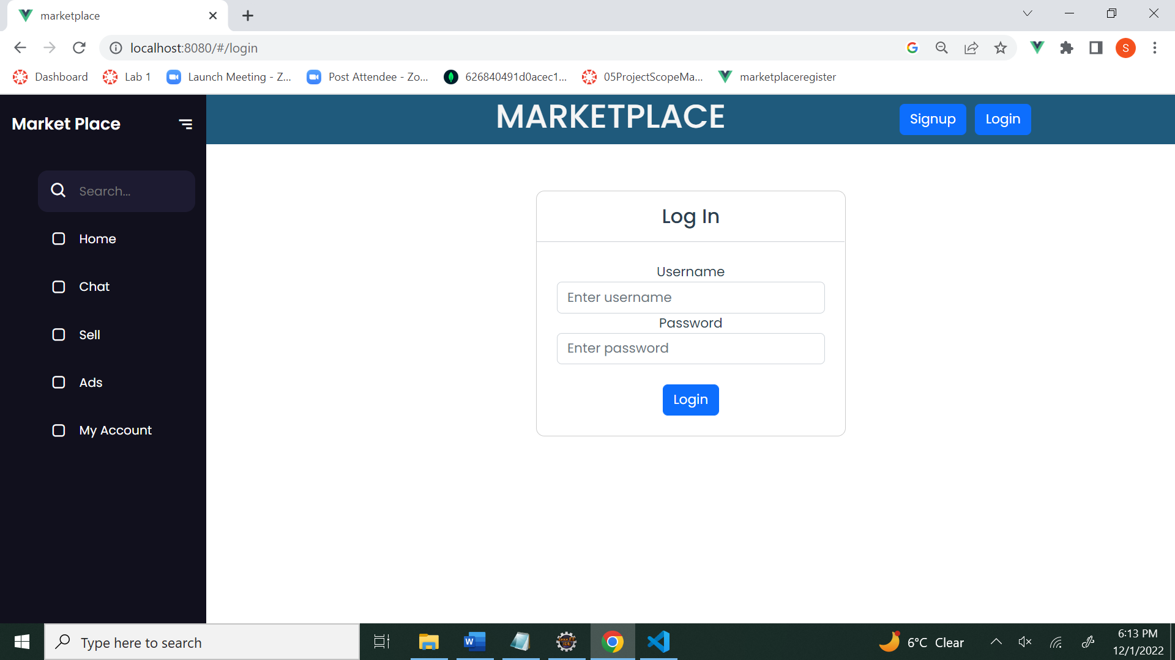
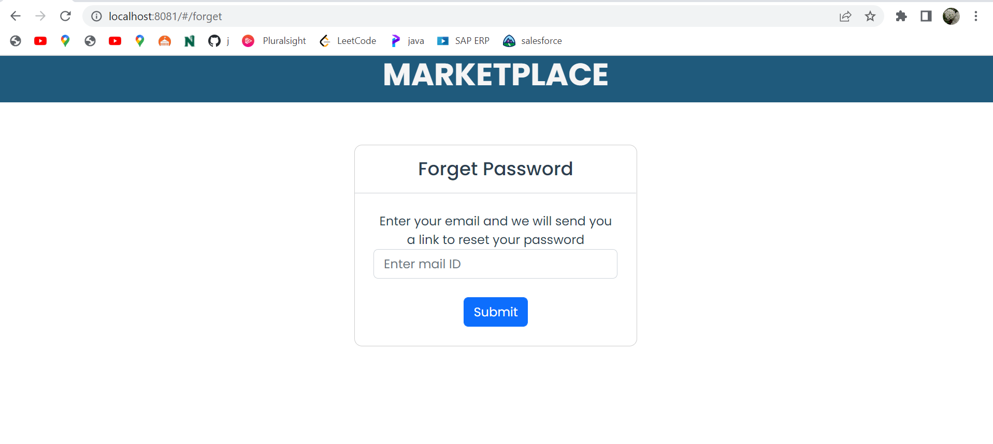
LOGIN FUNCTIONALITY
Login Page
Forget Page
Fig.1.Login Page
Fig.1.2.Forget Password Page
Hari Kiran Aluri

Slide 8
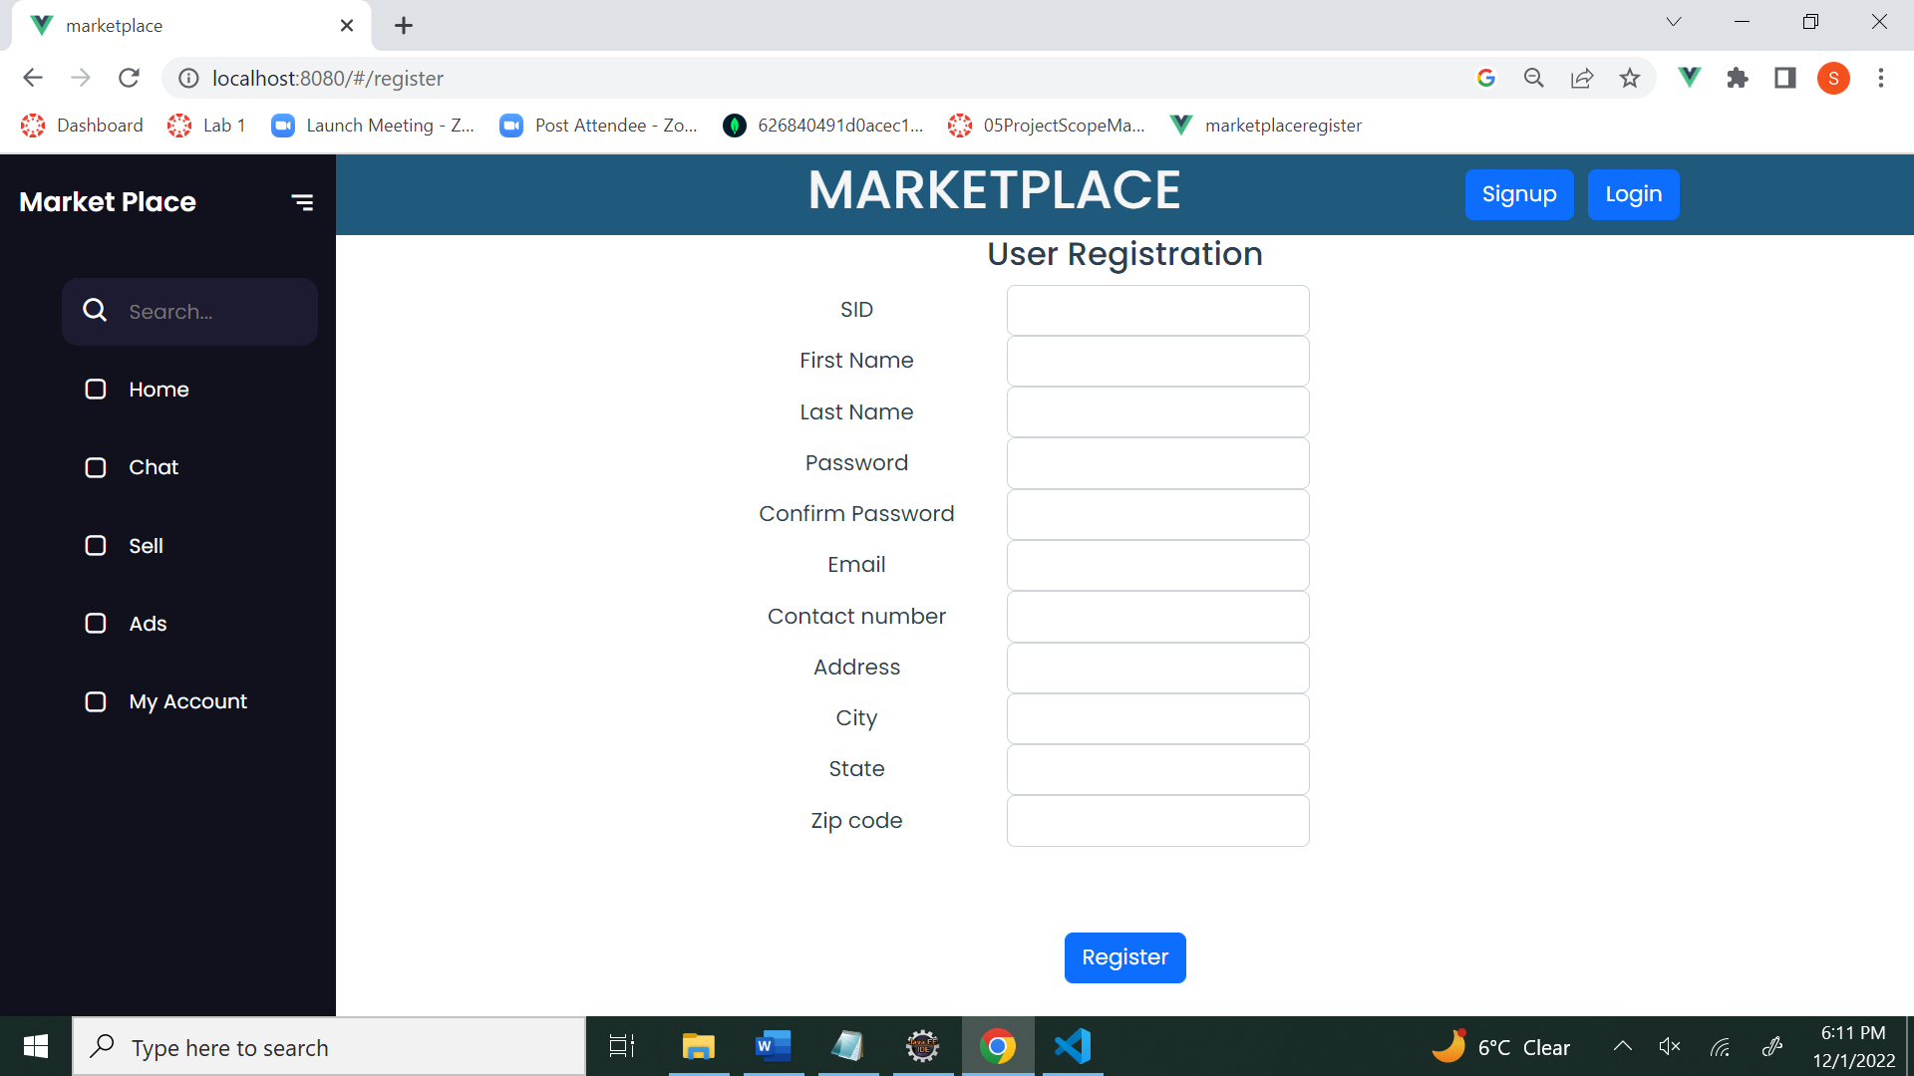
REGISTRATION FUNCTIONALITY
Fig.2.User Registration Page
Hari Kiran Aluri

Slide 9
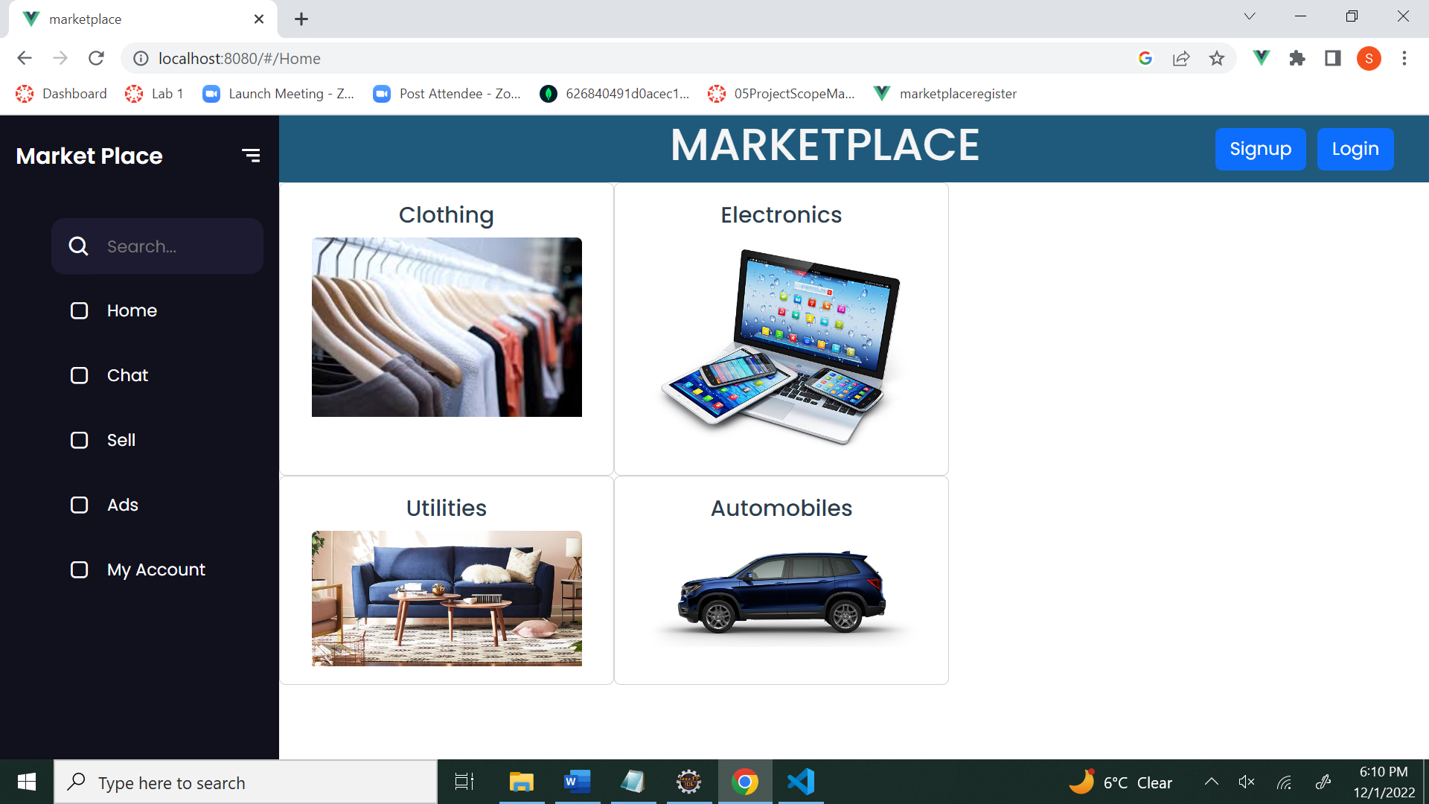
HOME PAGE
Fig.3.Home Page
Hari Kiran Aluri

Slide 10
SELL FUNCTIONALITY
User can sell products based on categories provided
Products not listed in the categories provided are considered as miscellaneous category
Upload multiple images related to the product
Based on the category selected, the respective product details would be displayed
Hari Kiran Aluri

Slide 11
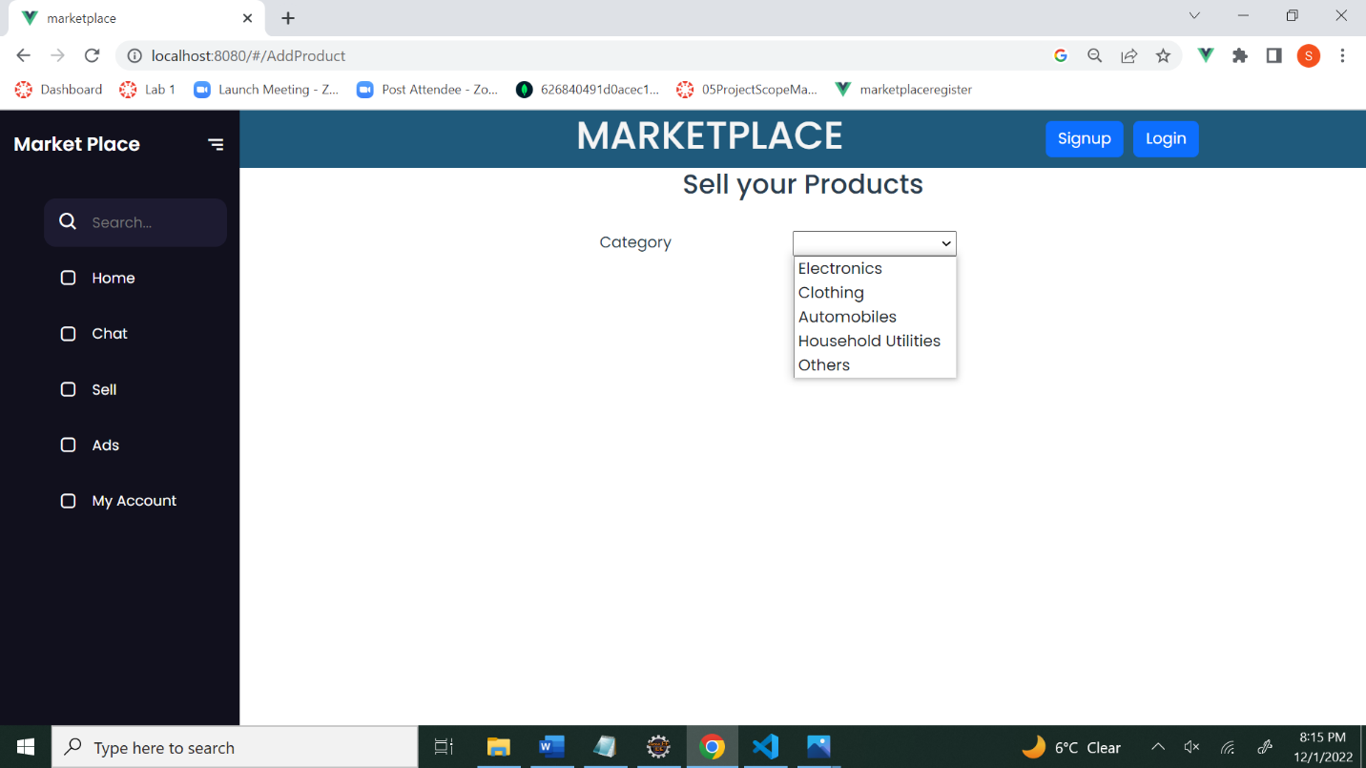
SELL PAGE
Fig.4.1 Sell Page
Hari Kiran Aluri

Slide 12
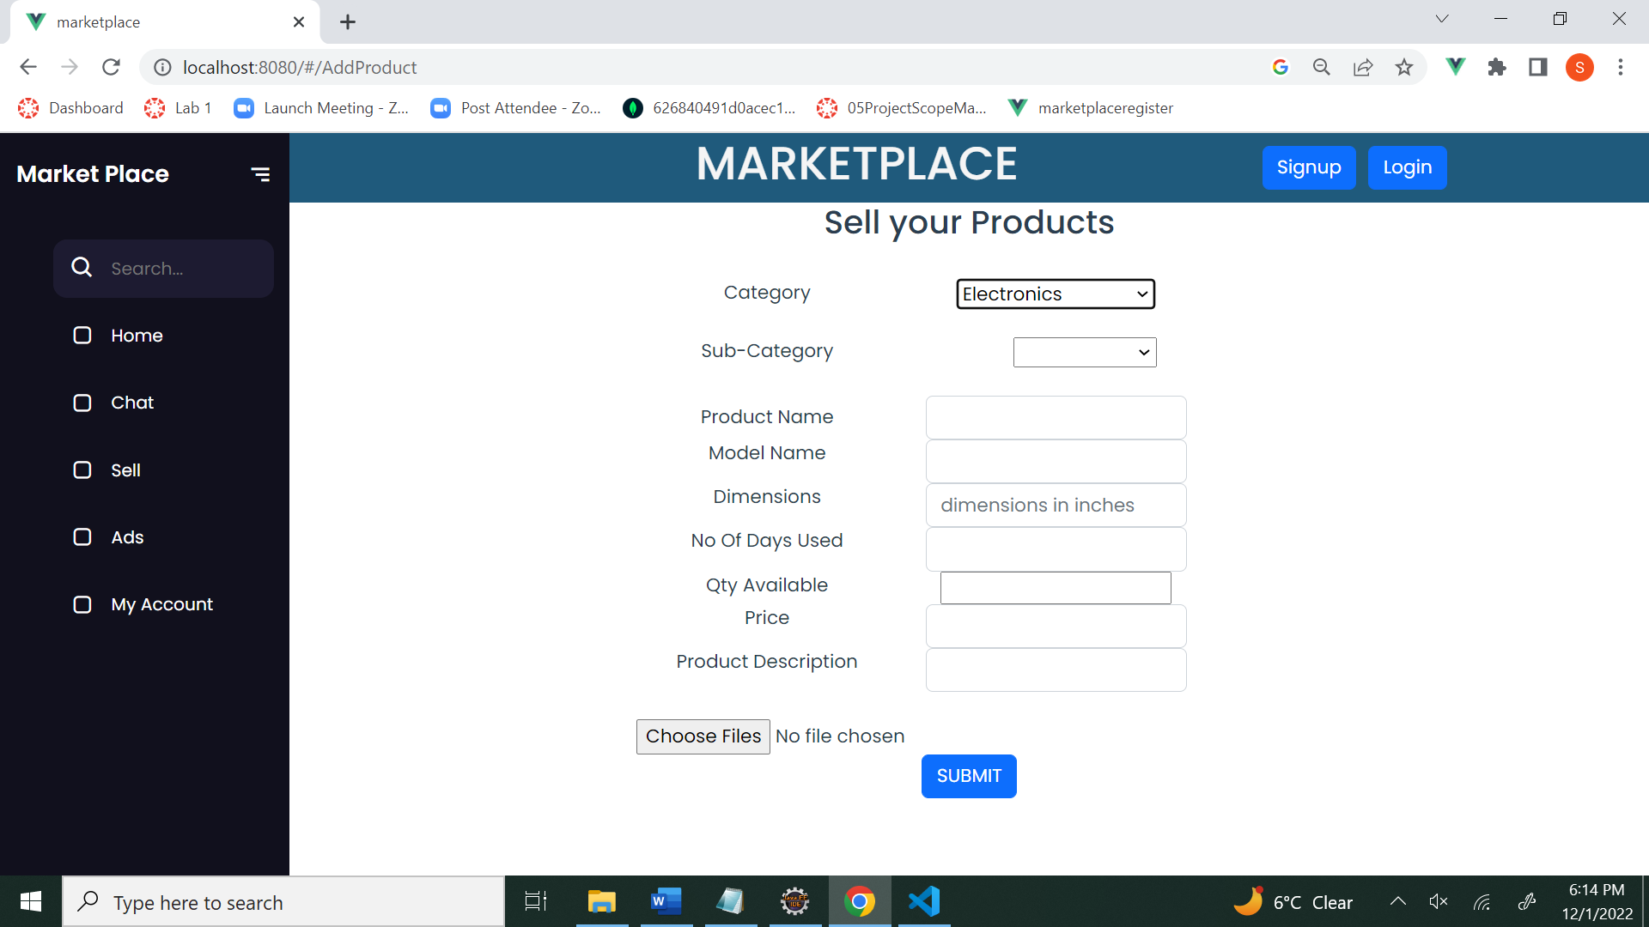

SELL PAGE
Fig.4.2 Sell Page for Electronics
Fig.4.3 Sell Page for Clothing
Hari Kiran Aluri

Slide 13
ADS FUNCTIONALITY
Users can view the advertised products
Images of the products and the price is displayed
Seller can update the product as sold in this page
Sajida Mohammad

Slide 14
LESSONS LEARNT
Faced issues when uploading images in BLOB format
Unable to pass the image to API from front-end
Saving the uploaded images in a path and storing the file names of the images in database
Due to subscription issues, migrated from free SQL database to Amazon RDS
Consumed 90% of the memory for free tier utilization. As a result, had to temporarily pause the database
Sajida Mohammad

Slide 15
FUTURE IMPLEMENTATIONS
Need to provide front-end validations
Buyer functionality need to be implemented
Chat functionality where user’s entire chat history can be viewed
My Account functionality where the user can update settings like profile image, contact information, password change
UI level filtering and DB level filtering to display products
Usha Pati

Slide 16
SUMMARY
Develop a web application where Northwest students/faculty purchase and sell products
Used spring boot, Amazon RDS and Vue in building the application
Implemented Sell and Ads functionalities
Usha Pati

Slide 17
REFERENCES
Git Link : https://github.com/harichowdary-aluri/gdp_1-project
Vue: https://vuejs.org/guide/essentials/application.html
Spring boot: https://docs.spring.io/spring-boot/docs/current/reference/html/
Thankyou: https://tenor.com/view/thank-u-hi-wave-thanks-thank-you-for-listening-gif-16104062
Any Questions: https://tenor.com/view/any-more-questions?-enthiran-amazon-prime-video-trending-rajinikanth-gif-17834798816845745719
Usha Pati

Slide 18


Slide 19
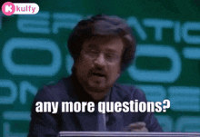

Slide 20
TEAM MEMBERS
DR.CHANDRA MOULI
KOTTETI
KIRAN KUMAR
GUNDAPUNENI
HARI KIRAN ALURI
SAJIDA MOHAMMAD
USHA PATI

Slide 21
MARKET PLACE FOR NORTHWEST MISSOURI One place to buy and sell
SEC03 TEAM03
DR. CHANDRA MOULI KOTTETI – Client/Mentor KIRAN KUMAR GUNDAPUNENI – Back End Developer HARI KIRAN ALURI – Back End Developer SAJIDA MOHAMMAD – Front End developer USHA PATI – Front End Developer

